Slide 2

Consume Sales Cloud Data from Marketing Cloud with GraphQL
Luciano Straga, Salesforce Architect Team International @stragaluciano | lucianostraga@gmail.com

Slide 3


Luciano Straga
Salesforce Architect Team International

Slide 4
Session Agenda
Things to learn today:
THE CHALLENGES TO SOLVE
Segment audience
Connecting Sales Cloud with Marketing Cloud
Today’s solution
GraphQL
SSJS in Automation Studio
Live DEMO!

Slide 5
Today’s Segmentation Challenge
Send recurring CSAT email to contacts that:
Are C-Level/VP/Directors
Belongs to accounts with opportunities for more than 100K
Created service cases in the past

Slide 6
Today’s Technical Challenge
Technical requirements
Data is on Sales Cloud
Account
Contacts
Opportunity
Case
Emails will be sent from Marketing Cloud every 3 months
Validate data is in sync from Sales Cloud

Slide 7
Today’s Integration Challenge
Connecting to Marketing Cloud - Options
Marketing Cloud
Connect ?
SF -> Marketing Cloud (API) ?
Marketing Cloud -> Salesforce (API)?

Slide 8
Connecting to Marketing Cloud
Marketing Cloud Connect
OOTB managed package
Syncs Salesforce data as Synchronized Data Extensions (read-only)
The user defines objects and fields to be synchronized
Segmentation in Automation Studio with SQL queries
Need to sync Opportunities and Cases on Marketing Cloud for today’s essay. BLOCKER

Slide 9
Connecting to Marketing Cloud
SF -> Marketing Cloud (API)
Outbound integration using Marketing Cloud APIs
New MC connected app
Apex Code hitting SOAP Marketing Cloud APIs
for writing on Data Extensions
Segmentation in Salesforce with SOQL queries and scheduled Apex Jobs
High Effort

Slide 10
Connecting to Marketing Cloud
Marketing Cloud -> SF (API)
Marketing Cloud inbound integration using SF APIs
Scheduled SSJS activity on Automation Studio
SSJS activity consuming
REST API
GraphQL API
SSJS updating data on Data Extensions with native functionality
Low effort

Slide 11
The Proposed Solution
SSJS on Automation Studio + GraphQL API

Slide 12
Automation Studio
Automation and Scheduling Framework
Scheduled vs On Demand
Activities
SQL Queries
Send Emails
Server Side Javascript tasks (SSJS)
Other ETL tasks

Slide 13
Server Side Javascript
Complete platform for scripting automation
Runs on MC backend
Built-in Library
HTTP support
Native access to MC data model
Could be run on Cloud Pages

Slide 14
GraphQL API on Salesforce
Communication pattern for sending and receiving data
Single endpoint for interaction with the SF Platform
Multiple (n) queries on same request
Aggregate data
Request fields
Schema secured - UA API enforced - LWC adapter
Mutations (winter24!)

Slide 15
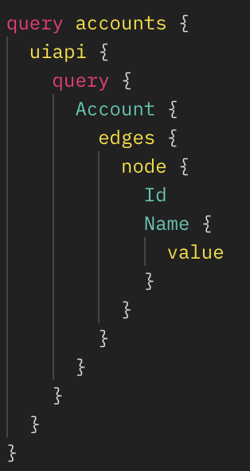
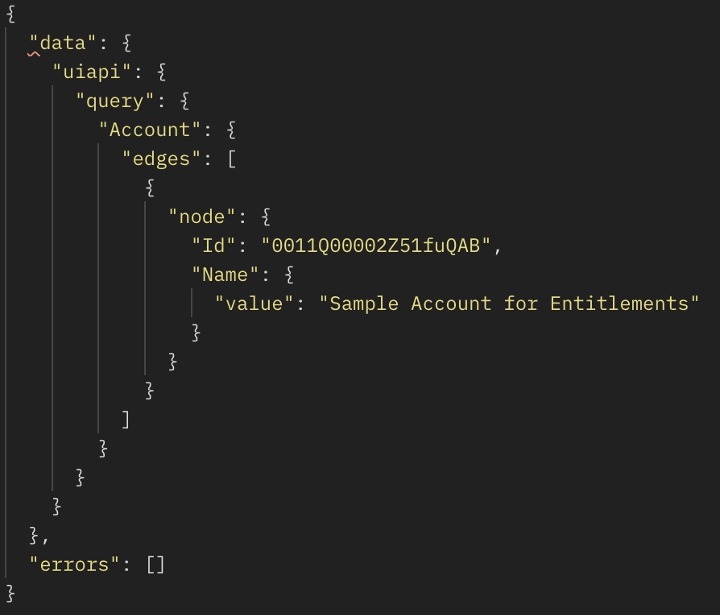
GraphQL query sample
POST -> https://{MyDomainName}.my.salesforce.com/services/data/v59.0

Slide 16
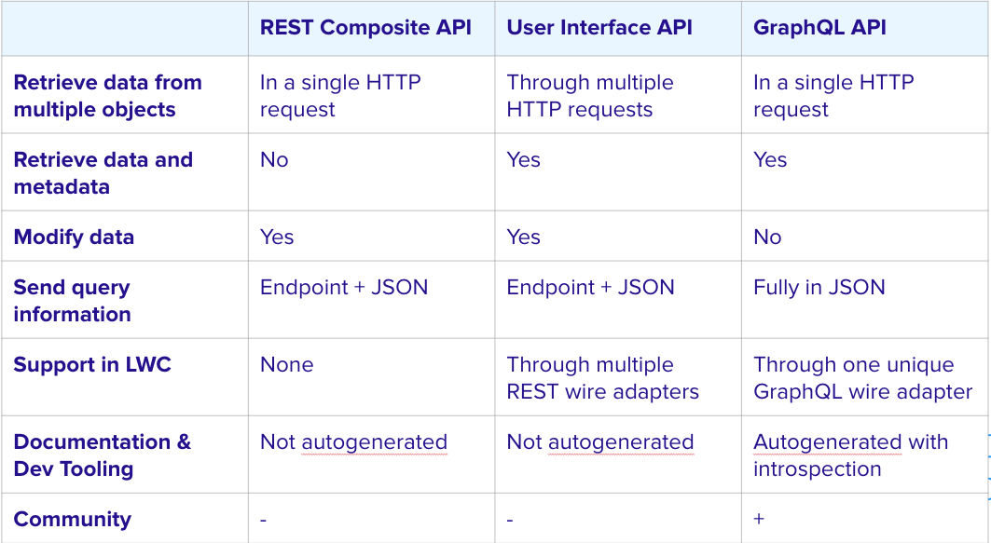
GraphQL API vs REST API
Capabilities

Slide 17
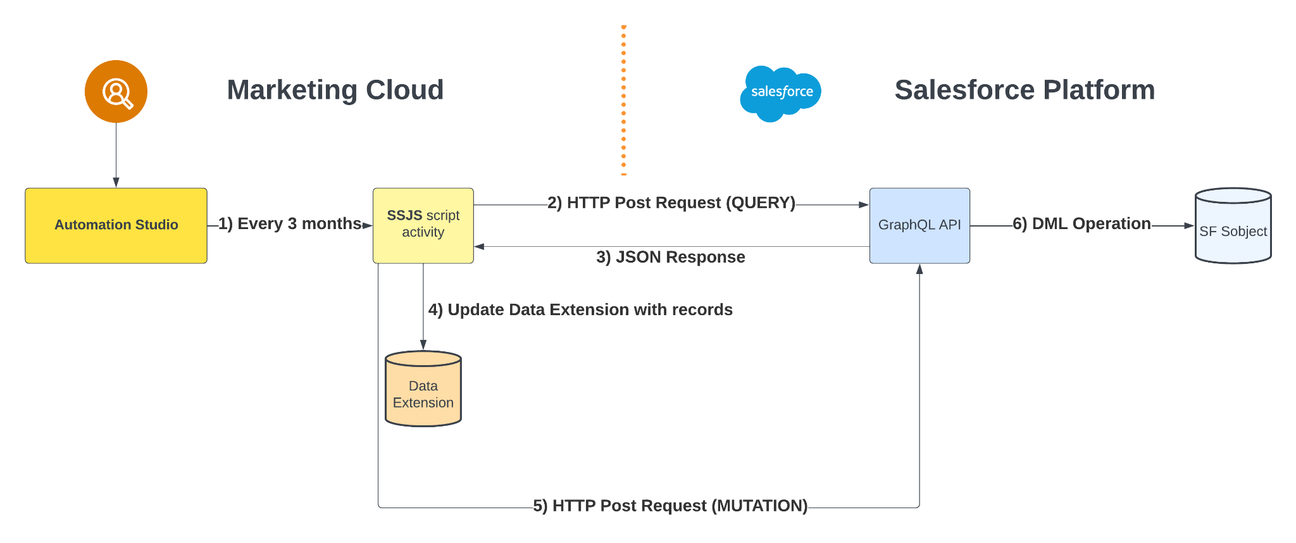
Architecture
Solution Flow

Slide 18
Architecture
The elements
Salesforce (Pre-release org-Winter24)
Connected App - (Client Credentials authentication flow)
New custom Datetime field on Contact (sync time stamp)
GraphQL query
GraphQL Mutation (winter24)
Marketing Cloud
Custom Data Extension
SSJS automation script activity

Slide 19
Time to DEMO!

Slide 20

Resources
Git Repo -> https://github.com/lucianostraga/marketing-cloud-graphql

Slide 22

















